Slide 1
Big Data / Hadoop PoC Architecture
Write a Wrapper on Social Media APIs to fetch Data
Data Set
Product
Demographic
Behavioral
Data Filter based on certain attributes
Fetching Set of Attributes from the Data Set
Data Integration
Generate Analytics
Reduce
Map1
Map2
Influencer
Visualization
Sentimental
Hadoop MapReduce Execution using Pig,Hive,etc
BI Integration

Slide 2
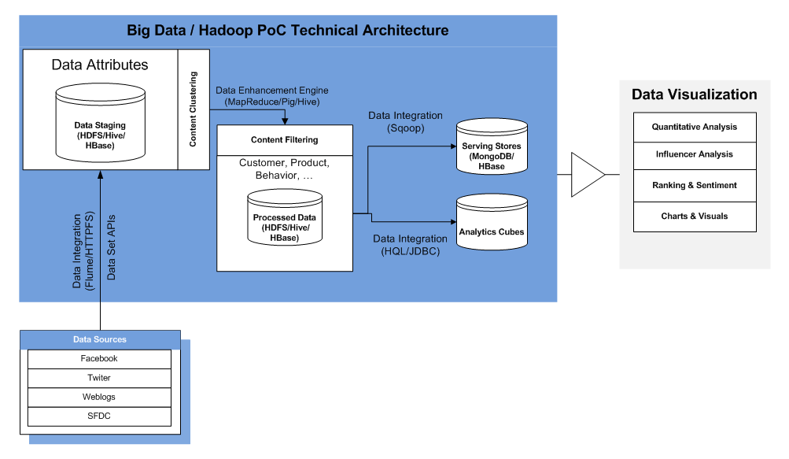
Big Data / Hadoop PoC Technical Architecture

